Slide 1

A.R.M. LiDAR System
Student: Calin Doran

Slide 2
Introduction
Overview
Understand the Problem
Project Objective
Main Features
Current State of Development
The Problems
What’s up Next
Project Timeline

Slide 3
Overview
The proposed application that is titled “A.R.M. LiDAR System” which stands for Avoidance and Route Mapping LiDAR System. This is intended primarily as a system that will enable potential users to detect objects or obstacles and path find a way around and or through them, mapping as it moves through the environment.
This mapping is done via a point cloud map, this is represented as a collection of points in a 3D shape, each point has its own set of X, Y and Z coordinates and in some cases have additional attributes.

Slide 4
Understand the Problem
01
Connecting a mobile unit to this application should provide the user with a set of parameters where they can control the unit remotely or additionally.
02
Once the MU or Mobile Unit, is on a route it should map the environment using the LiDAR scanner, this will give a 2D or 3D map of the area depending on the capability of the scanner connected.
03
Using this data, we will be able to see the MU’s point of view and map of the area it passed though and objects it avoided.

Slide 5
Project Objective
This project is about building an application around a LiDAR scanner, it can map objects in 2D and 3D along with mapping the environment in which it is in.
Utilizing this in an application will prove valuable in terms of object avoidance and route planning, as the idea is to develop a mobile unit that will connect to this application and will drive itself via a plotted route and avoid obstacles on the way.

Slide 6
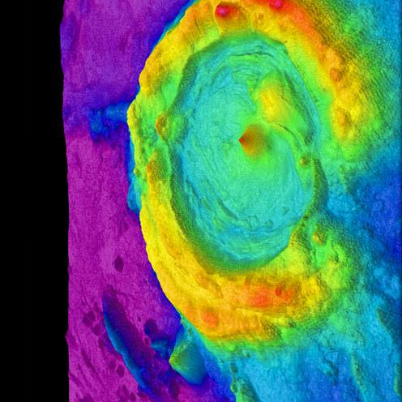
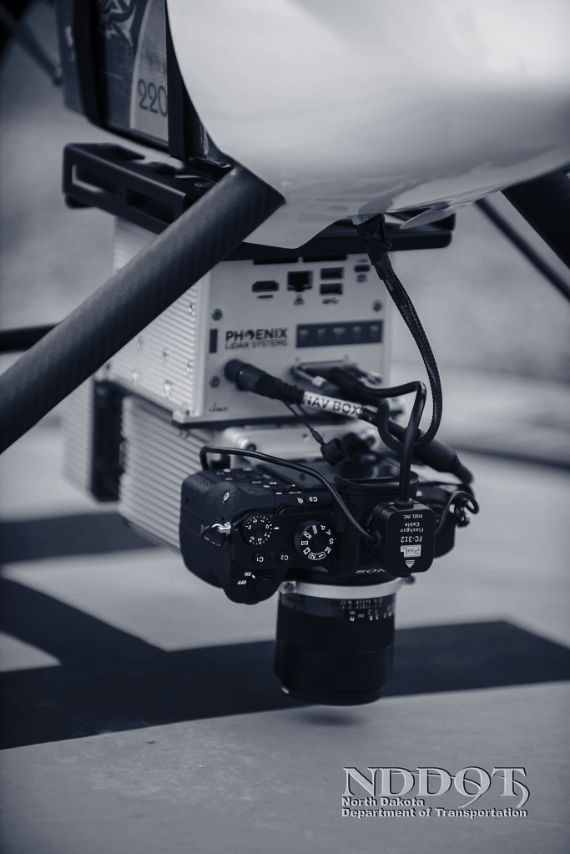
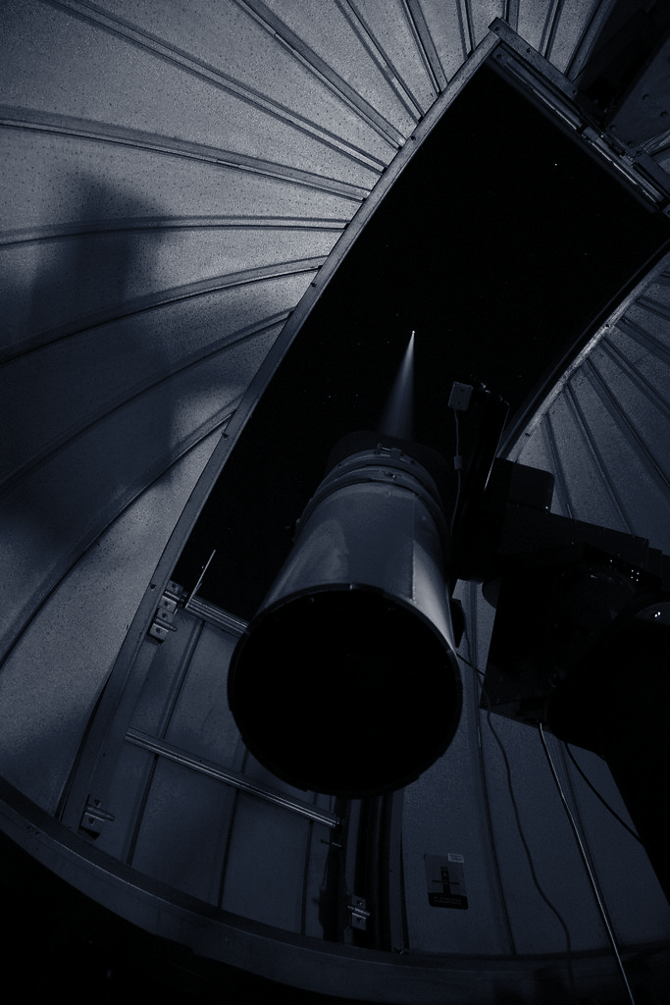
Main Features
The application will have a visual representation of what the LiDAR scanner can see in full 360-degree points of data.
Utilizing this data in the avoidance algorithm will allow for the scanner to see objects that get closer.
It will be displayed in a GUI that represents the data as large consistent lines or 3D shapes in the point cloud map.

Slide 7
Current State of Development
04
Prototype
Refine
Getting the technology's to play well with each other.
Make the application run well with minimum bugs.
01
03
Add Features
Get feedback
Adding more features to the application to be more feature complete.
Get feedback from testing the application and fixing major bugs that are blocks
02

Slide 8
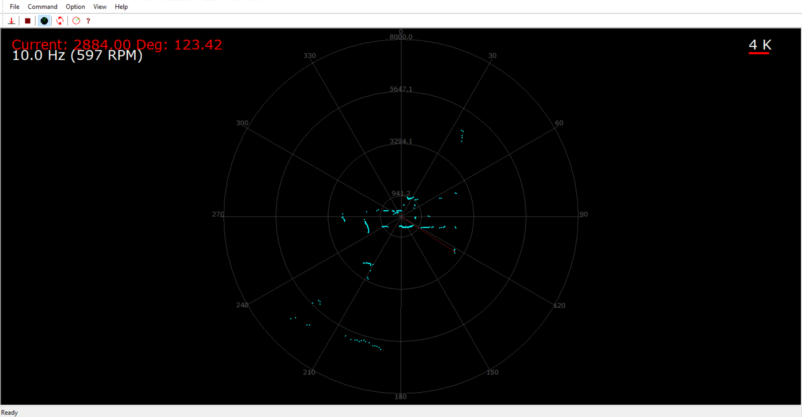
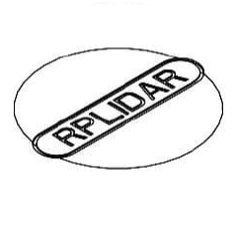
The Problems
Implementation of the SDK
Current SDK is not compatible with new IDE’s like VS2019.
Hard to implement for what needs to be done.
Documentation is good, however it is designed for depreciated IDE’s such as VS2010.
RPLiDAR
Multiple different versions of the same SDK

Slide 9
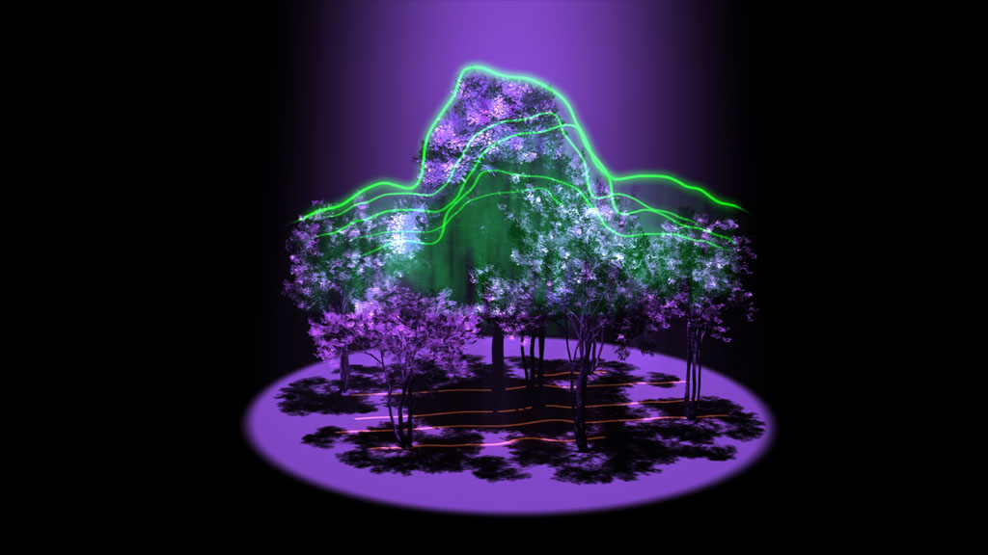
What’s up Next
Get the SDK working with the development tools I need.
Once this obstacle is overcome, the main development of the application can begin.
Then the integration of a Mobile Unit can begin.

Slide 10
Project Timeline
JAN
FEB
MAR
APR
MAY
Phase 1
Phase 2
Phase 3
Phase 4
Phase 5
SDK implementation and RND of the application.
Critical development of the application.
Bug and Test development of the application.
Projected finalization of additional features.
Final stretch of development, making sure the application works.

Slide 11
Thank you!
Questions?

